Slide 1
outlines
part1 rotate_splitcores_without_chunksize changing
part2 rotate_splitcores_with_chunksize_changing
1. compare modified(splitecores) rotate with unmodified rotate under same chunk/cores number
2. performance of modified(splitcores) rotate with varying chunk numbers under specific cores

Slide 2
Part1 rotate_splitcores_without_chunksize results shows: each test under different cores has a little bit of improvement (it did have the trend to move left)

Slide 4
splitcore Vs. normal rotate algorithm under specific core numbers = x

Slide 9
part2 rotate_splitcores_with_chunksize_changing

Slide 10
varying chunk numbers under dif threads
1. compare modified(splitecores) rotate with normal rotate under same chunk/cores number

Slide 11
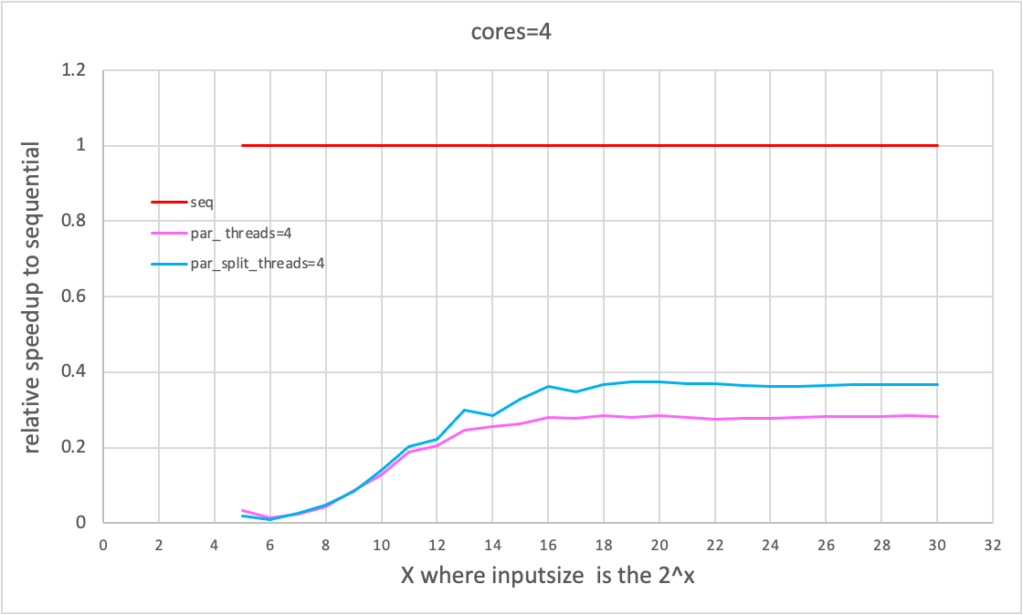
chunk number=4 cores=4

Slide 12
chunk number=8 cores=8

Slide 13
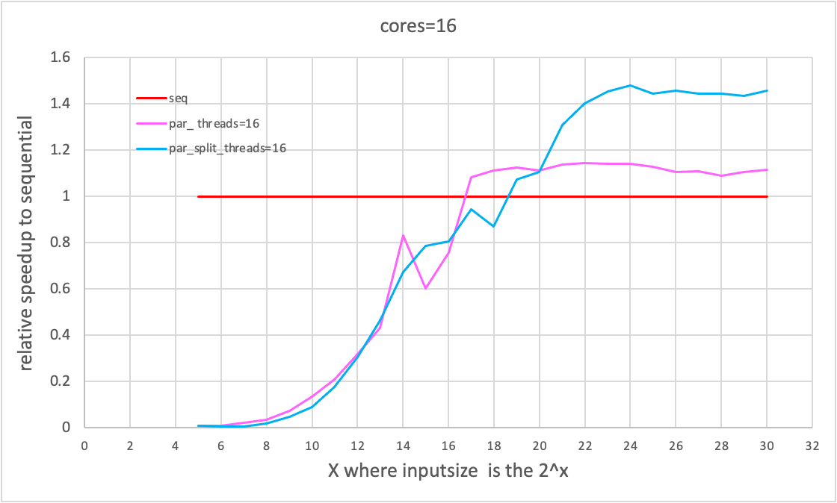
chunk number=16 cores=16

Slide 14
chunk number=32 cores=32

Slide 15
2. performance of modified(splitcores) rotate with varying chunk numbers under specific cores

Slide 16
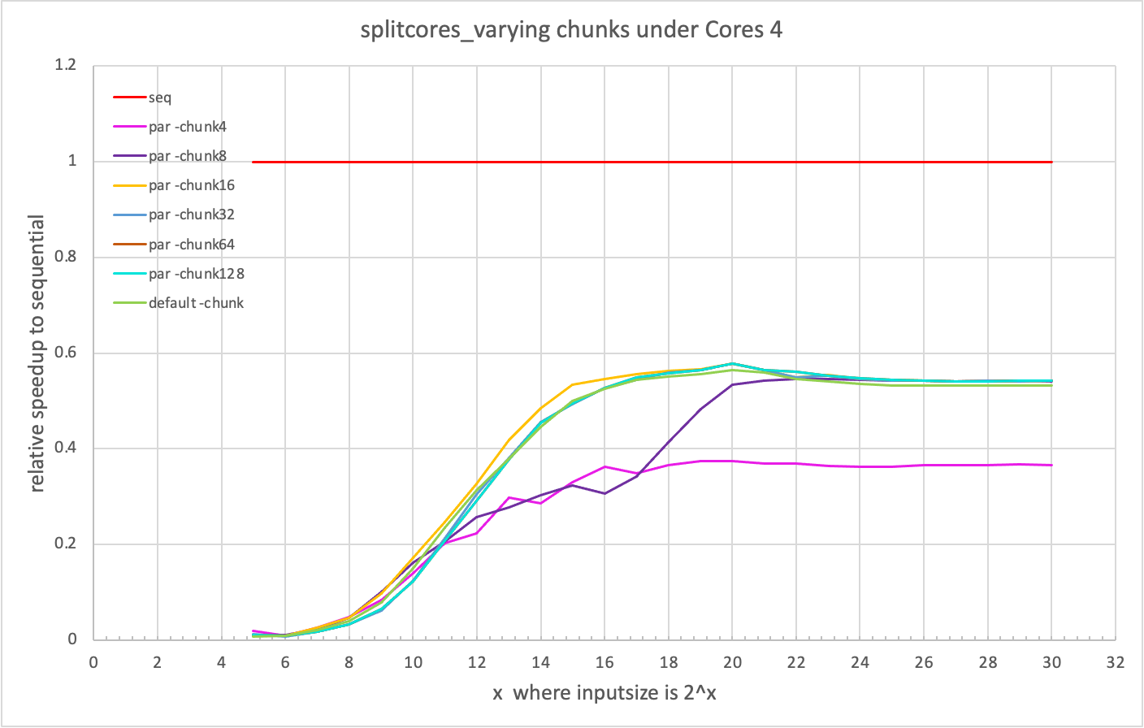

Slide 17
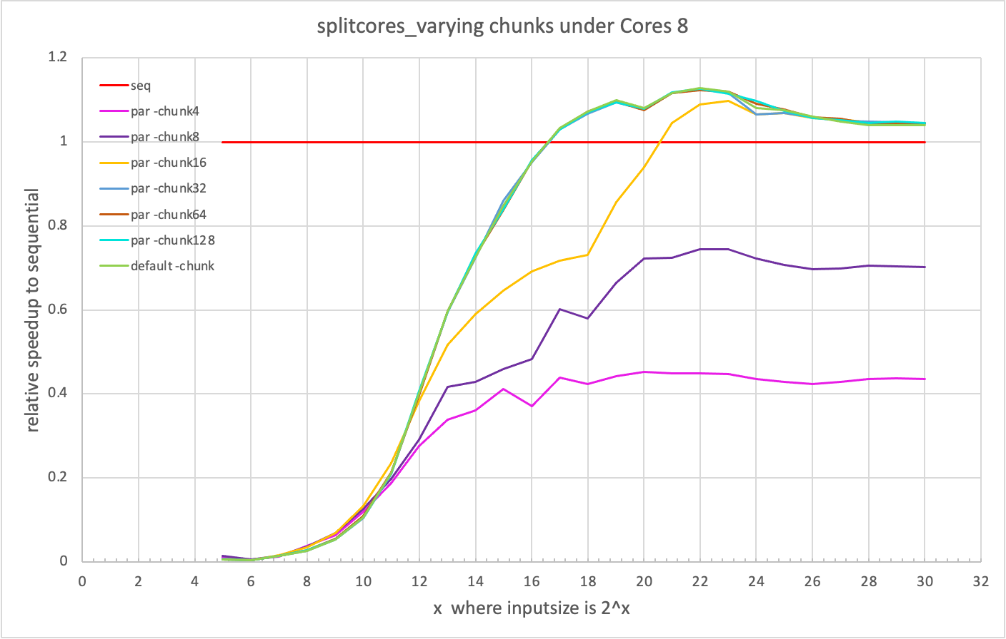

Slide 18
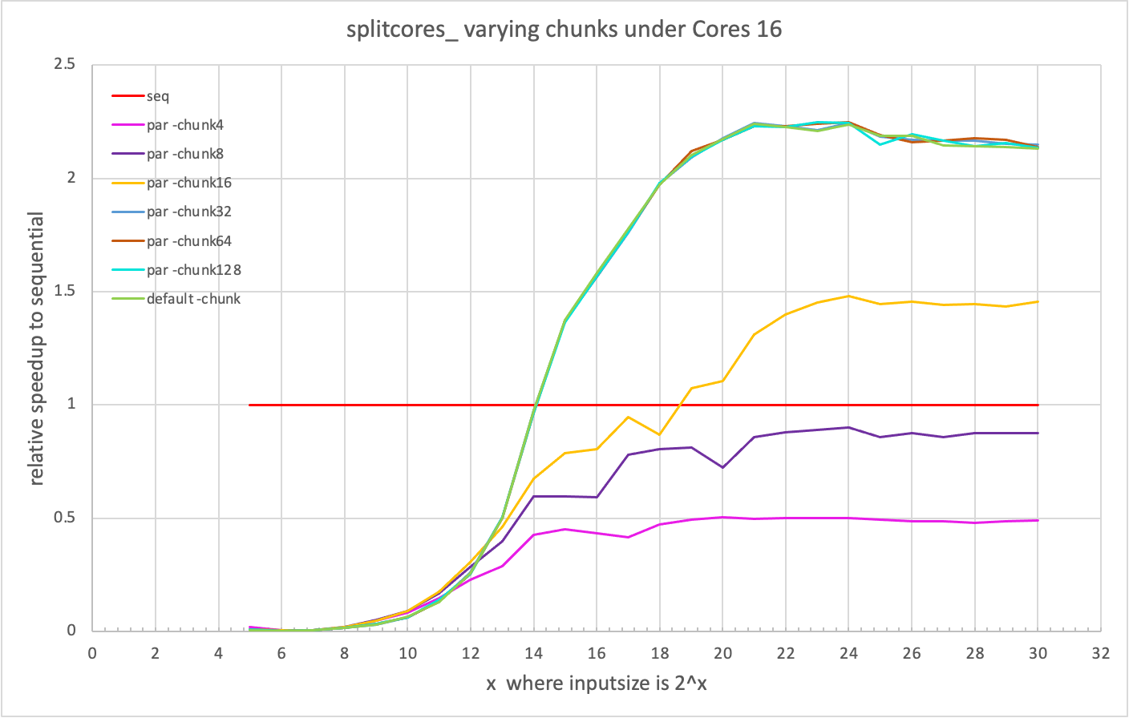

Slide 19
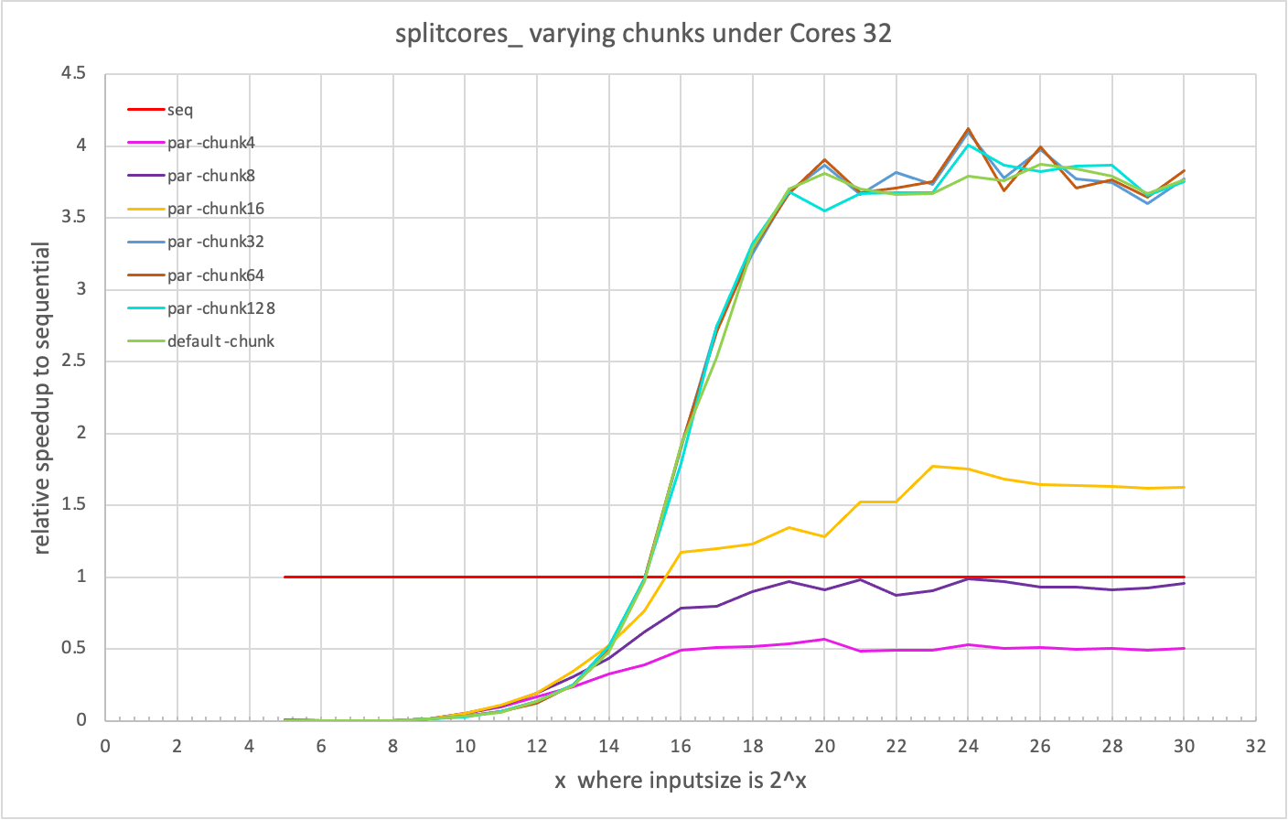

Slide 20
